Slide 1
TRAINING FOR FAMILIES OF CHILDREN WITH DOWN SYNDROME __
DOWN SYNDROME NETWORK OF MONTGOMERY COUNTY
Presented by Denise Bryant M.A., CCC-SLP, ATP & Ashley Lon M.S., OTR/L

Slide 2
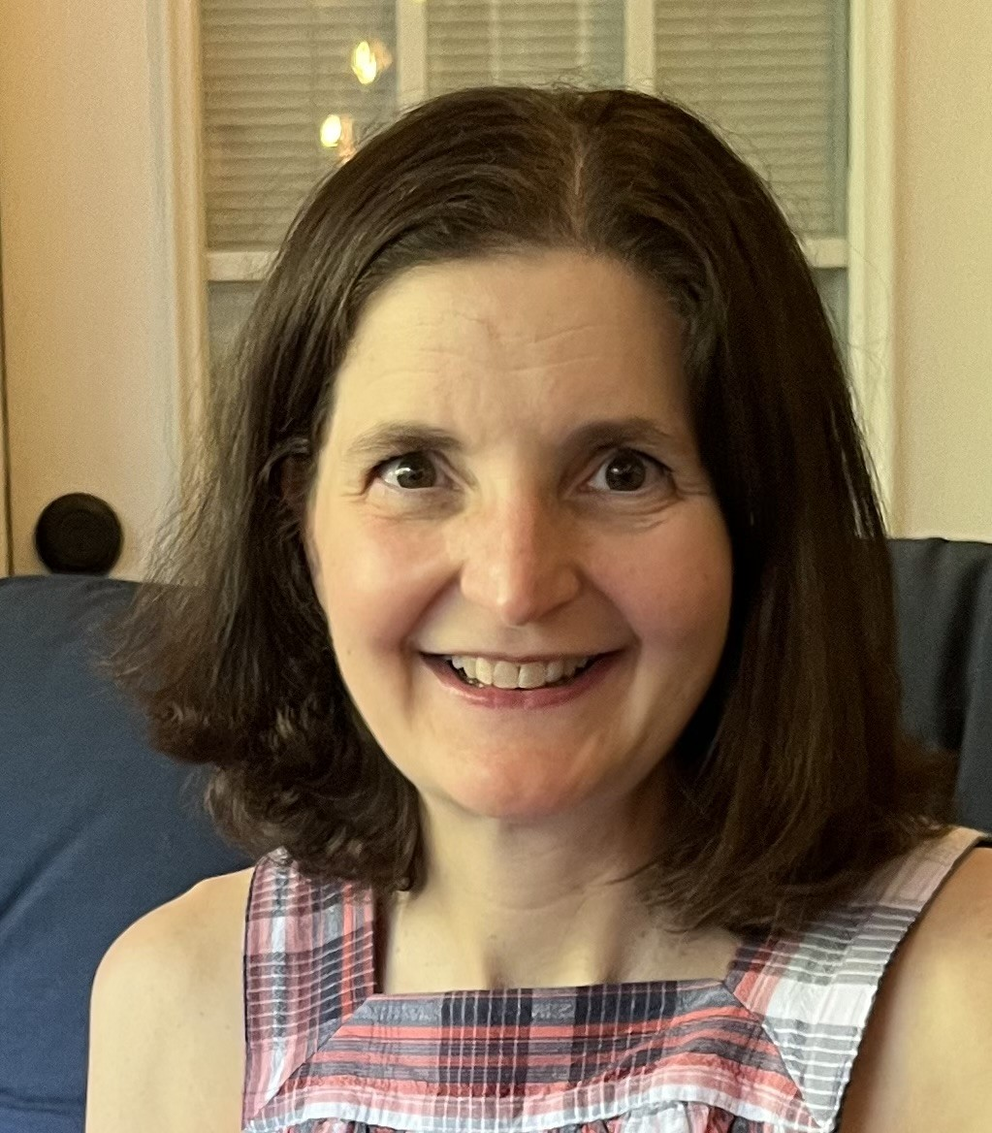
Denise Bryant, M.A., CCC-SLP, ATP,
Denise is a pediatric speech-language pathologist at The Treatment and Learning Centers (TTLC) in Rockville, MD. She has 29 years of experience working with children and families with complex communication needs. Prior to working at TTLC, Denise worked at Vanderbilt Medical Center and served on the multidisciplinary team for the Vanderbilt Children’s Hospital’s Down Syndrome Clinic.

Slide 3
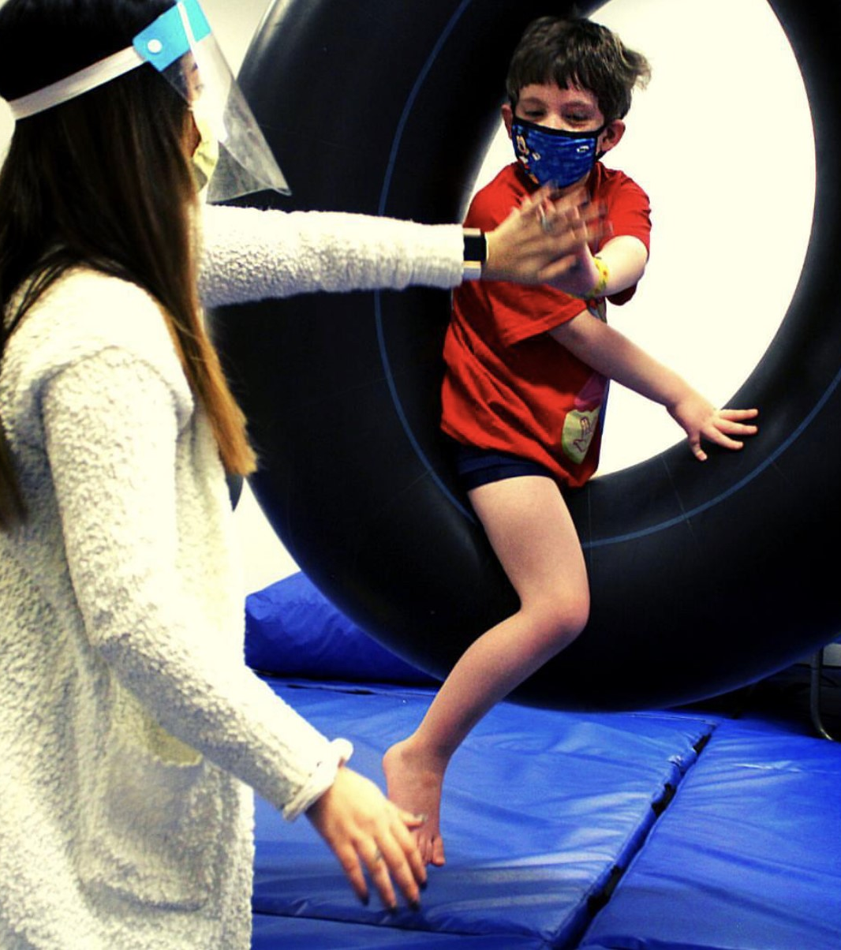
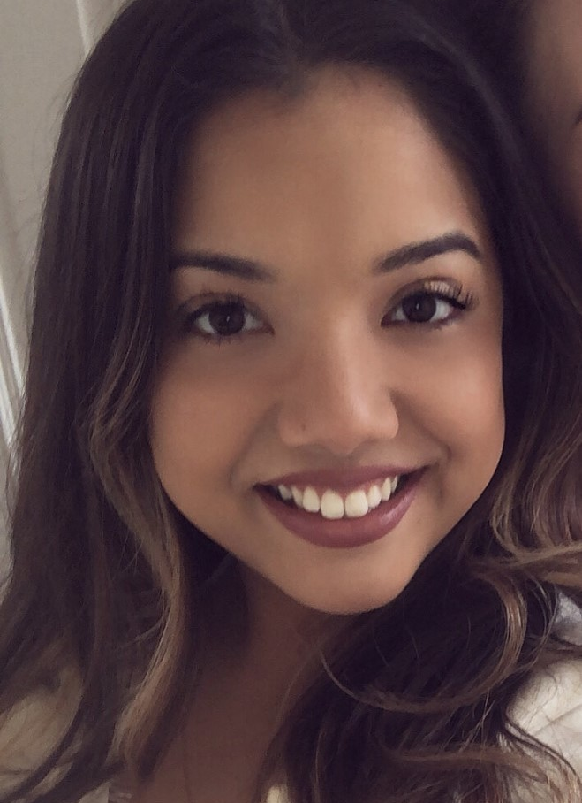
Ashley Lon
M.S., OTR/L
Ashley has enjoyed being a pediatric occupational therapist since she graduated from University of Maryland with her Bachelor's in Kinesiology and Nova Southeastern University with a Master's in Occupational Therapy. Extensive training and both professional and personal experience working with children with disabilities has led Ashley to have a passion for and specialize in Pediatrics with a focus on Sensory Integration, Behavior Interventions, and Pediatric Mental Health. She currently treats kids of all ages with the primary goal of improving the overall quality of life of both the children and their families from a holistic and client-center approach.

Slide 4
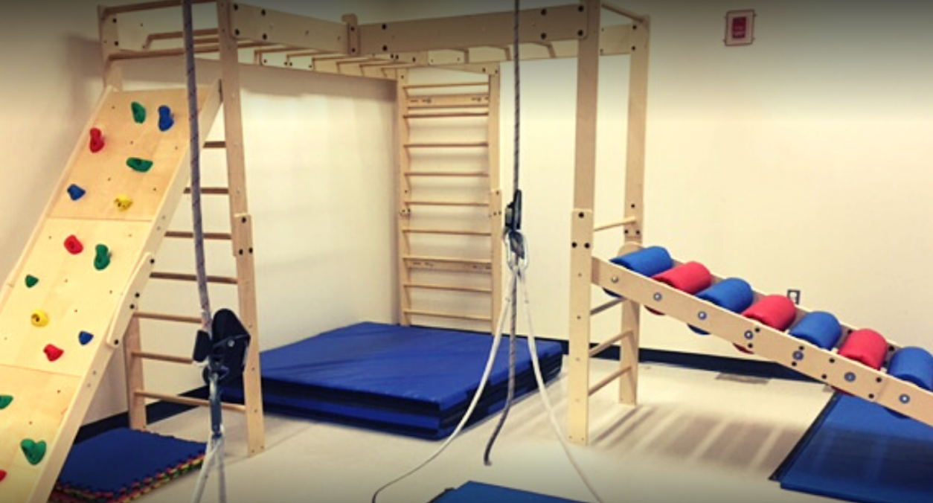
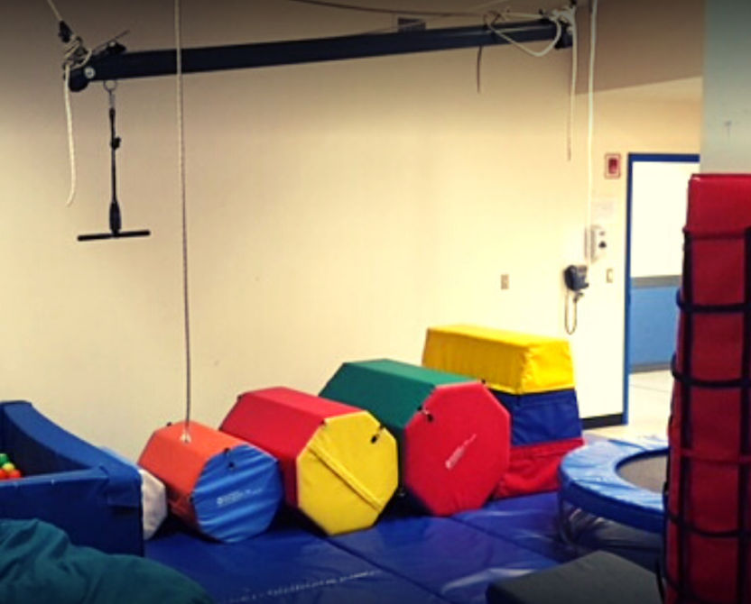
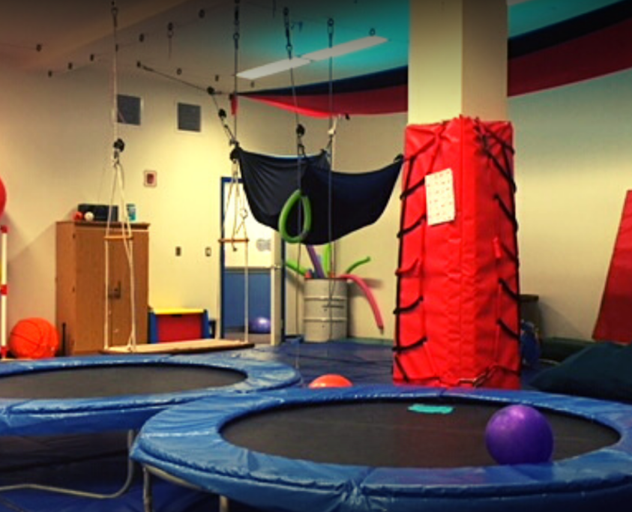
THE TREATMENT AND LEARNING CENTERS (TLC)
Located in Rockville, MD

Slide 5
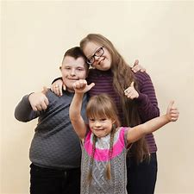
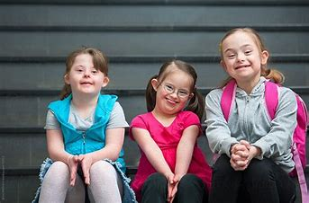
Special Considerations when working with Children with Down Syndrome
Medical History
Sleep Apnea
Hearing
Vision
Feeding Difficulties
Dual Diagnosis of Autism

Slide 6
Speech-language Characteristics of Children with Down Syndrome ___________
Oral-motor structures
Oral-motor function
Speech/
Articulation
AAC
Sign Language
Visual Supports
Receptive Language stronger than Expressive Language
Difficulties with Phonology and Syntax

Slide 7
Sensory and Motor Characteristics of Children with Down Syndrome ___________
Activity Level/Arousal Level
Attention
Self-Regulation
Posture
Core Strength
Muscle Tone
Gait & Walking Patterns

Slide 8
Agenda ___________
Explore areas of function for children and adolescents with Down Syndrome through the Speech and OT Lens. Focusing on the following domains:
Play as an Occupation
Self-Care/Hygiene/ADL Routines
Sensorimotor/Gross Motor Skills
Social Participation
For each domain, we will:
Define the domain
Describe the skills addressed during the activity
Provide example activities to do at home

Slide 9
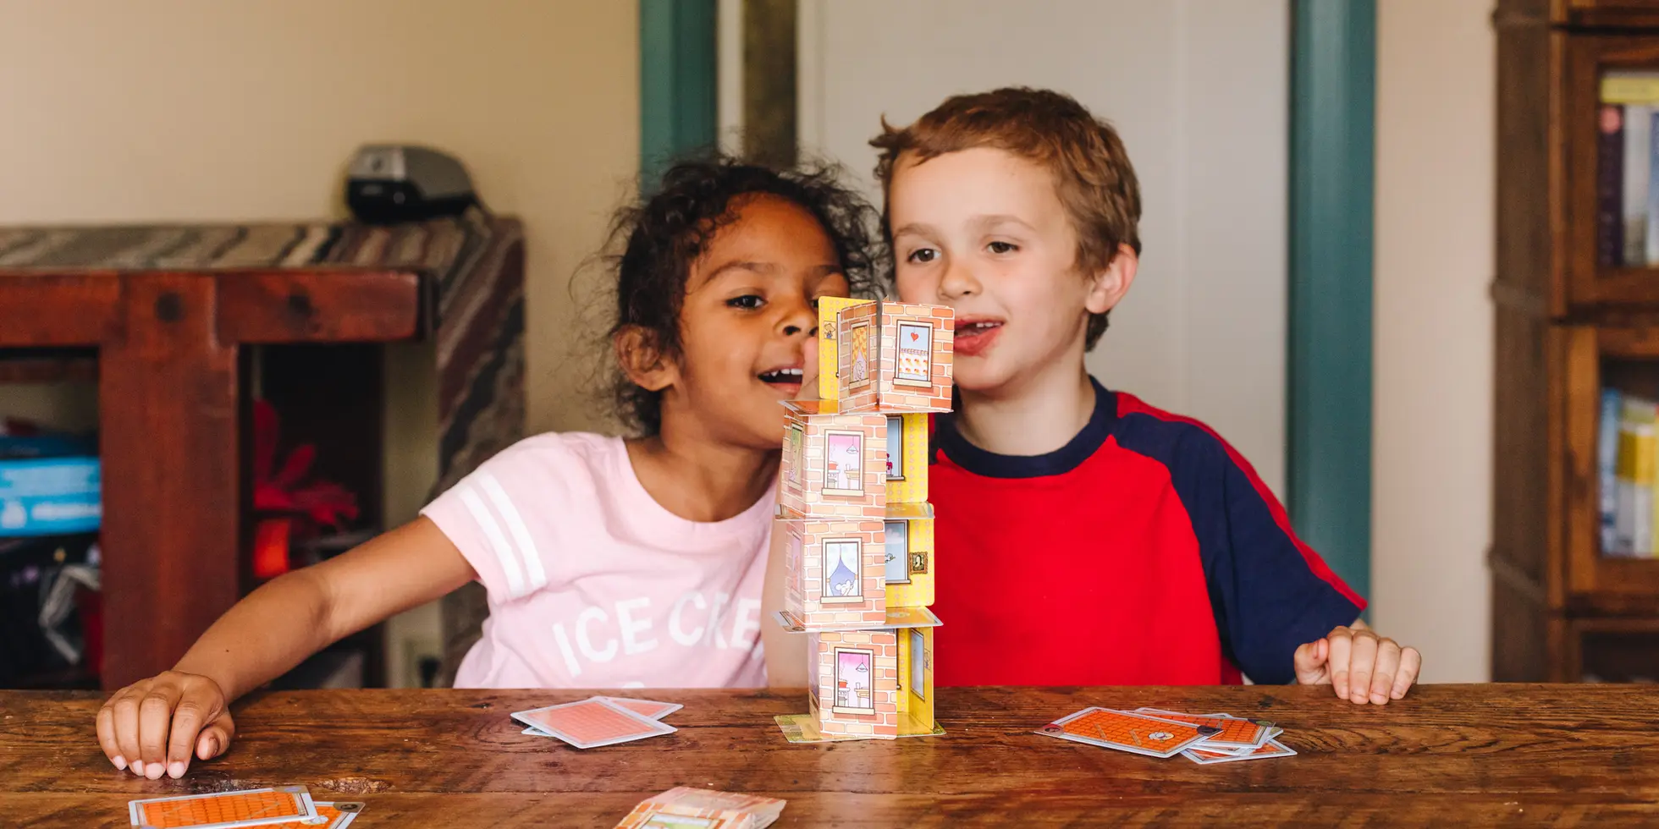
What is play?
Define:
Play is defined as “any spontaneous or organized child-directed activity that is an interaction between the child and the environment, which “provides enjoyment, entertainment, amusement or diversion” (Parham & Fazio, 2008:448).
Skills:
Turn-taking (impulse control)
Regulating Emotions (winning vs. losing)
Making decisions
Following directions
Builds vocabulary: nouns, verbs, describing words
At-Home Activities:
Dramatic play and dress up
Board games/card games
Simon Says

Slide 10
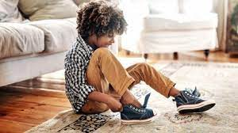
What are Self-Care Routines/ADLs?
Define:
Self care skills are defined as “the everyday tasks undertaken so children are ready to participate in life activities (including dressing, eating, cleaning teeth). They are often referred to as the activities of daily living (ADL’s). While these are typically supported by adults in young children, it is expected that children develop independence in these as they mature.”
Skills:
Receptive communication
Expressive communication-requesting help, asking questions
Planning and organizing
Managing Time
At-Home Activities
Use Visual Supports, Timers, and Reward Charts
Chores-video modeling
Older kids-keep a calendar or planner
-help with meal planning and preparation

Slide 11
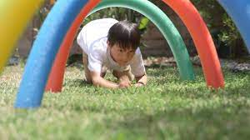
What are sensorimotor/gross motor skills?
Define:
Sensorimotor/Gross Motor Skills are defined as “skills that involve the process of receiving sensory messages (sensory input) and producing a response (motor output)”.
Skills:
Expanding vocabulary-action words, descriptive words, prepositions
Imitation-importance of motor imitation
Memory/sequencing-word combinations reinforced by sequencing motor movements
At-Home Activities
GiGi’s Playhouse virtual classes
Yoga
Obstacle Course
Water play-great to pair with books (e.g., Mrs. Wishy Washy, The Pigeon Needs a Bath)

Slide 12
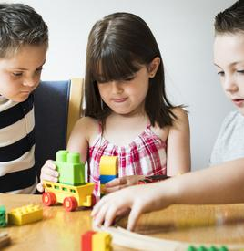
What are skills for social participation?
Define
Social skills are a set of rules that people use to interact and communicate with each other. Good social skills are important as they help us to establish relationships and encourage behaviors that are age-appropriate and culturally acceptable. Social skills include verbal and non-verbal communications, personal coping skills, and interpersonal interactions.
Skills:
Active listening
Reaching a compromise
Expressing Empathy
At-Home Activities:
Conversation topic bag
Role play social situations
Social Stories
Photo: https://www.123rf.com/stock-photo/down_syndrome.html

Slide 13
Resources:
National Down Syndrome Society
Resources | National Down Syndrome Society (NDSS)
Books:
Early Communication Skills for Children with Down Syndrome: A Guide for Parents and Professionals (Topics in Down Syndrome) by Libby Kumin
Helping Children with Down Syndrome Communicate Better: Speech and Language Skills for Ages 6-14 (Topics in Down Syndrome) by Libby Kumin

Slide 14
Resources, continued:
Gigi’s Playhouse virtual programming
GiGi's At Home - Virtual programs for individual with Down Syndrome (gigisplayhouse.org)

Slide 15
Thank You!
For information regarding speech-language therapy and occupational therapy at TLC:
Joanna Kolker
Audiology and Outpatient Assistant
301-424-5200, ext. 159
jkolker@ttlc.org
Presenter Contact information
Denise Bryant, M.A., CCC-SLP, ATP
Speech-Language Pathologist
Assistive Technology Professional
301-424-5200, ext. 212 dbryant@ttlc.org
Ashley Lon, M.S., OTR/L
Occupational Therapist
301-424-5200, ext. 260
alon@ttlc.org

